Slide 1
AI Agent for Chemical Explainability
Department of Life Science Informatics, B-IT
Lamarr Institute for Machine Learning and Artificial Intelligence
LIMES Institute Program Unit Medicinal Chemistry
Rheinische Friedrich-Wilhelms-Universität Bonn

Slide 2
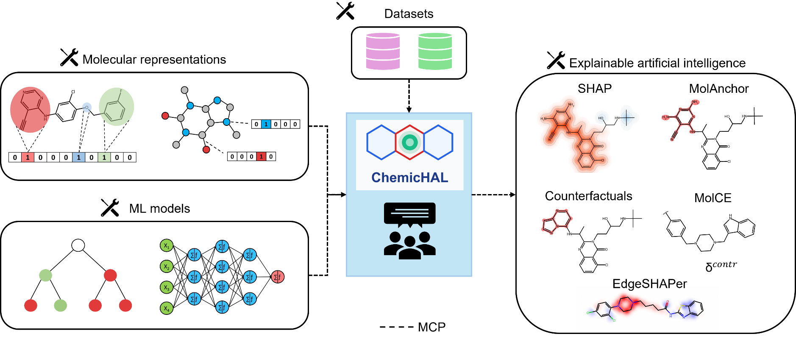
Study idea
MCP-based Agent for ML compound explainability

Slide 3
Study idea
Framework
LM Studio + Open Source LLM (GPT-OSS, Qwen 3.6, Gemma 4, etc.)
ML models
Traditional ML – RF, SVM
NNs – DNN, GNN
Explainability methods
SHAP
MolAnchor
Counterfactuals
MolCE
EdgeSHAPer

Slide 4
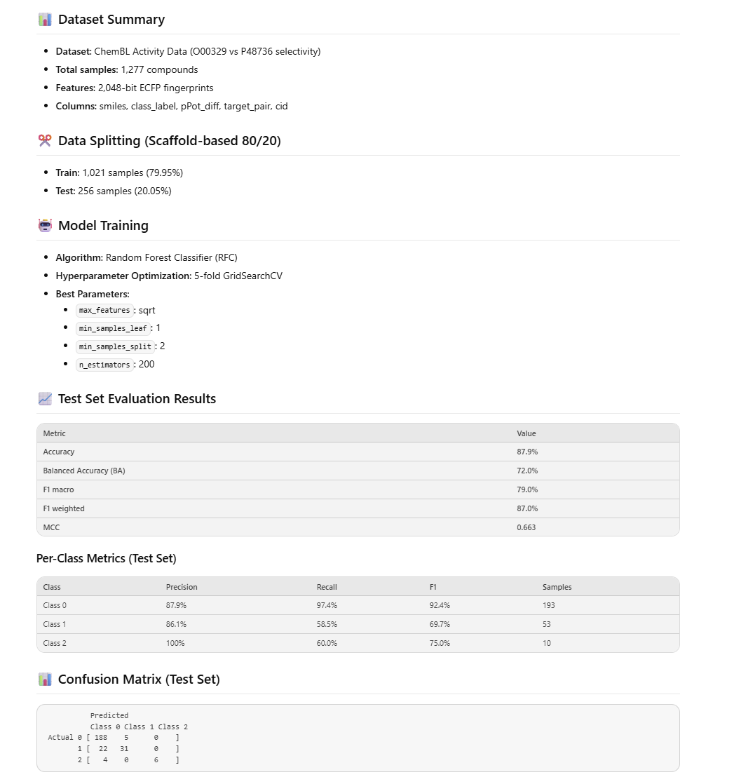
Practical Example - ML
ML prompt
For the given curated dataset ‘kinase_selectivity.csv’
Split the data using a scaffold split using a ratio of 80%/20% train/test
Train an RF model and perform a 5-fold CV for hyperparameter optimization
Calculate and display the test set performance using appropriate metrics
Notes:
Here's a concrete example.
The user asks the system to take a kinase selectivity dataset, split it using scaffold partitioning, train a random forest with cross-validated hyperparameter optimization, and report performance.
The agent handles all of this autonomously. This workflow would normally require writing and debugging a Python script — here it's done through a text prompt.

Slide 5
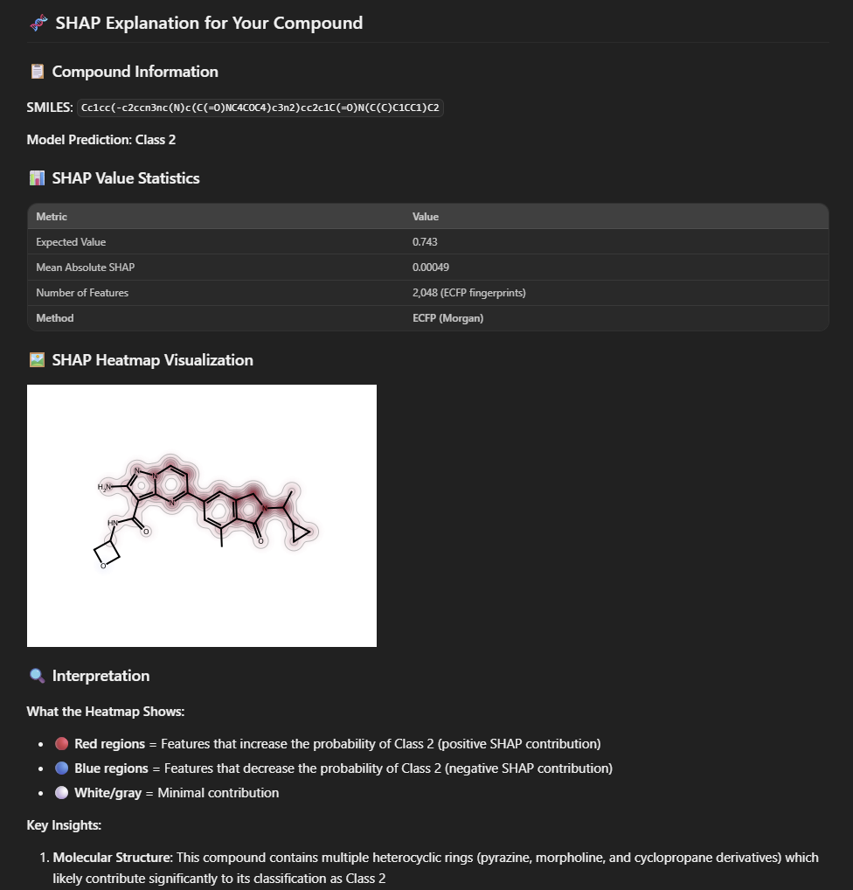
Exemplary answer output SHAP
Ask the model to explain an ML prediction for a given compound with SHAP
Get explanation statistics
Display explanation mapping
Rationalize explanations (LLM)

Slide 6
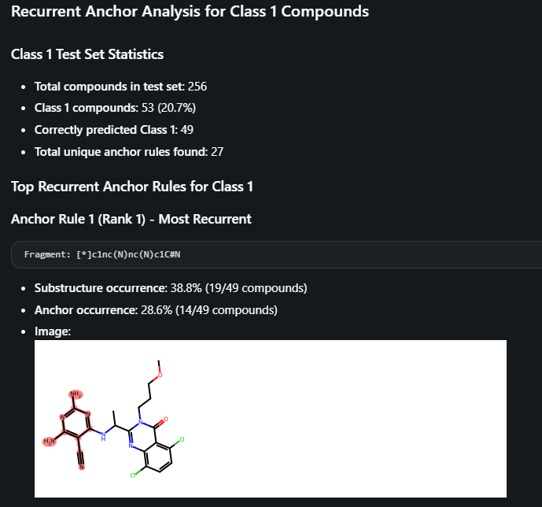
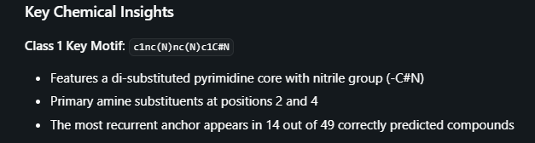
Exemplary answer output MolAnchor
Ask the model to explain an ML prediction n for a given compound with MolAnchor
Get explanation statistics (Anchor and substructure occurrence)
Global explanations also available
Rationalize explanations (LLM)

Slide 7
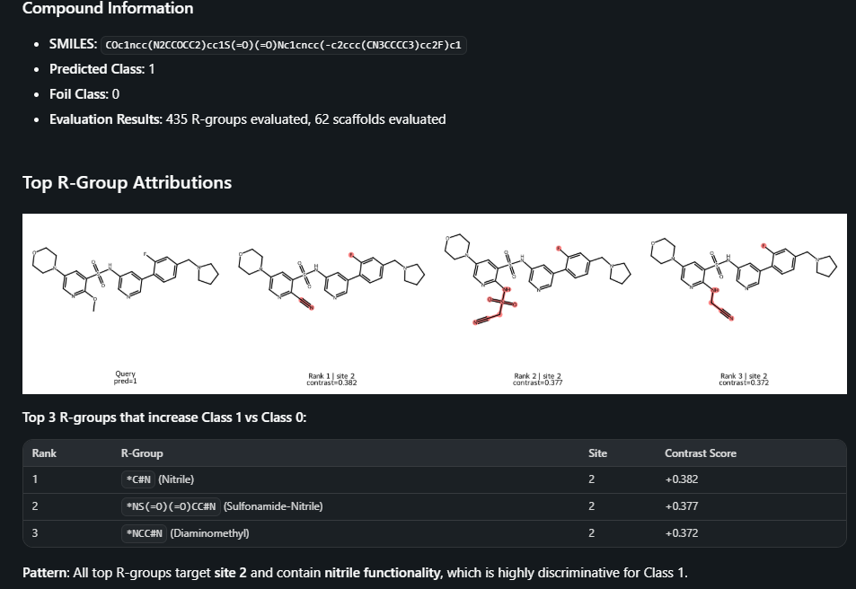
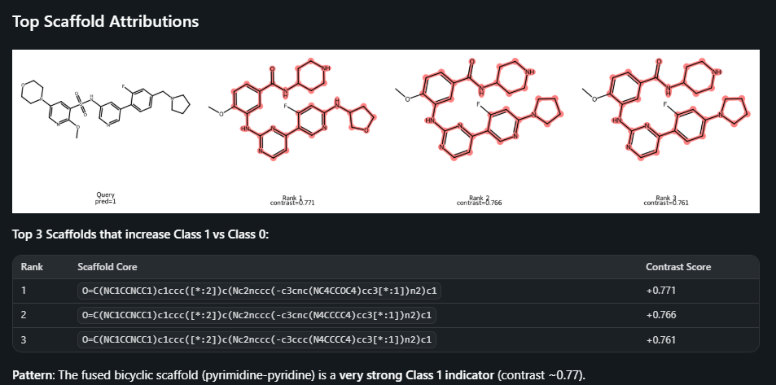
Exemplary answer output MolCE
For instances: See both substituent and scaffold foils
Get explanation statistics (occurrence, contrastive score)
Global explanations also available
Rationalize explanations (LLM)

Slide 8
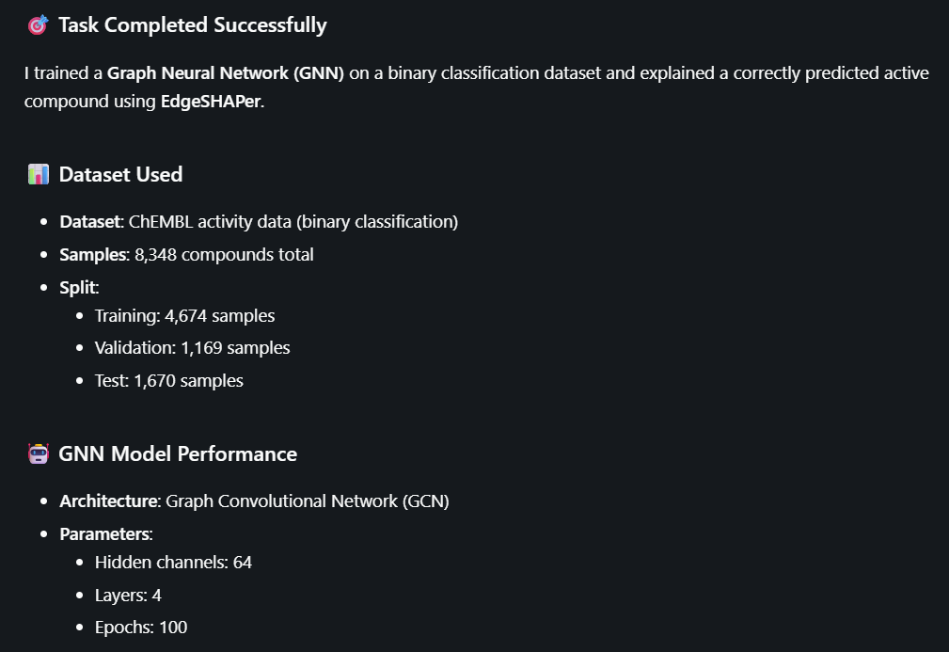
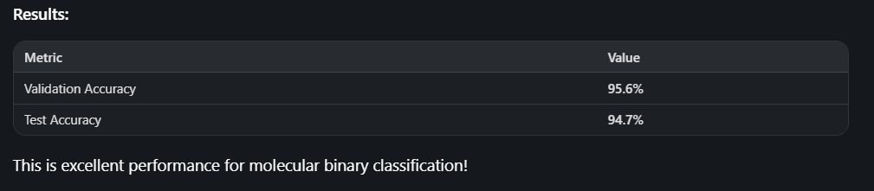
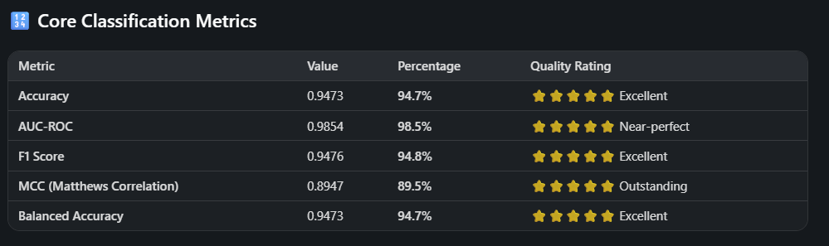
Exemplary answer output EdgeSHAPer
Prompt: Train a GNN model on a binary dataset and explain a correctly predicted active compound
LLM selects the architecture
Reports results

Slide 9
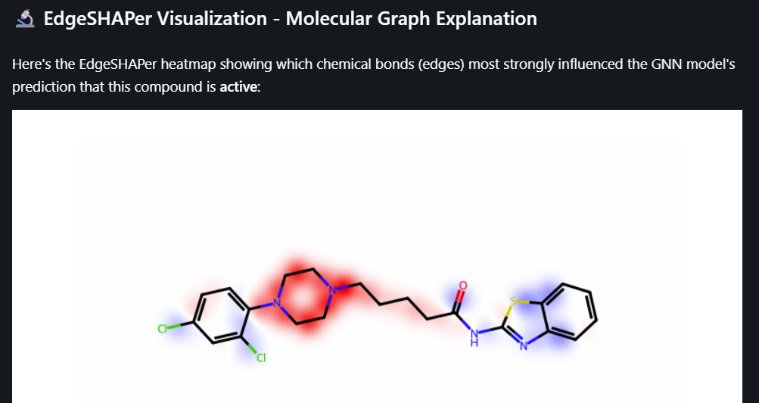
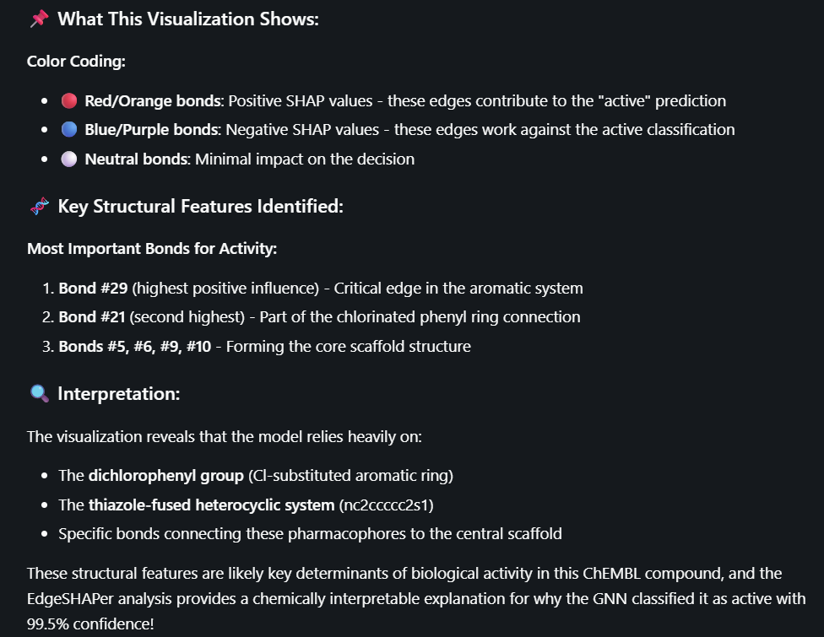

Exemplary answer output EdgeSHAPer
Explanation with EdgeSHAPer
Visualization
Interpretation by LLM

Slide 10
Agent Advantages and Improvements
Practical advantages
Visual aid for chemists → Increase transparency in ML predictions
Built on Open-source LLMs → Accessible to the community
Points to evaluate and improve
Susceptibility to LLM hallucinations → Use domain-specific models
Requires careful prompt curation → Addition of interactive chat feature
Notes:
The practical advantages: it serves as a visual aid for medicinal chemists, increasing trust in ML predictions through transparency.
It's fully integrated with an LLM, so it's ready to use.
And it's built on open-source models, making it accessible and adaptable to different needs

Slide 11
To do list
Integrate with cluster for faster inference and explore larger LLMs
It works already on the workstations with medium-to-large LLMs
Clean up the repository and make it available
An “organization repository” is available for the whole lab to ease the integration of new components
Make a guide for lab members for the implementation of AI agents

Slide 12
Framing
How to frame the project:
A proof-of-concept study?
An explainability platform for XAI applied to molecular design?
An explainability platform for XAI specific to molecular selectivity?
A modular explainability-enhanced platform for chemoinformatics?

Slide 13
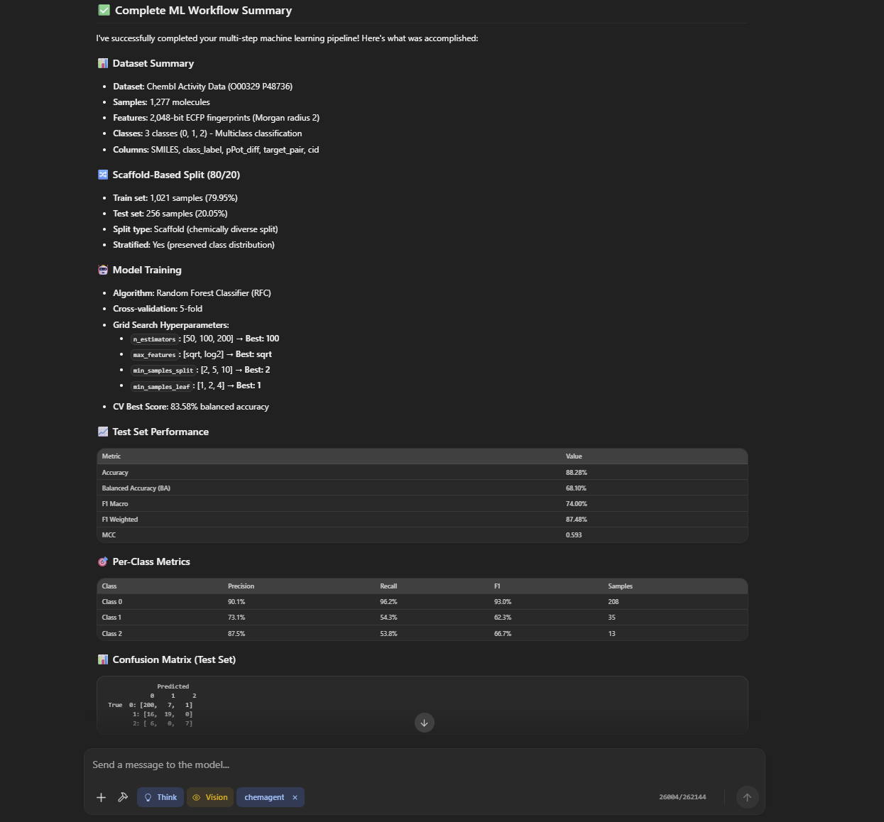
Exemplary answer output
Build an ML model for a given dataset
Get a complete report
Dataset summary
Data split statistics
Model training information
Test set performance

